Slide 1
Setting up
POINT-BASED GRADEBOOK

Slide 2
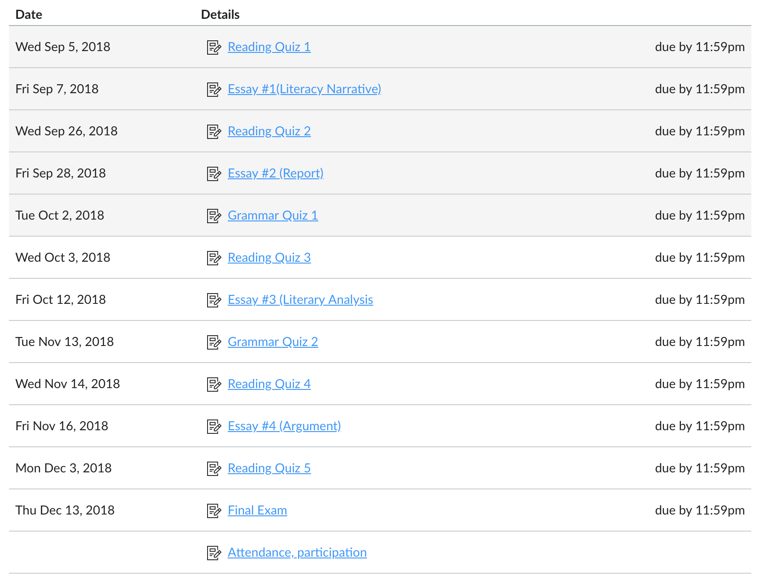
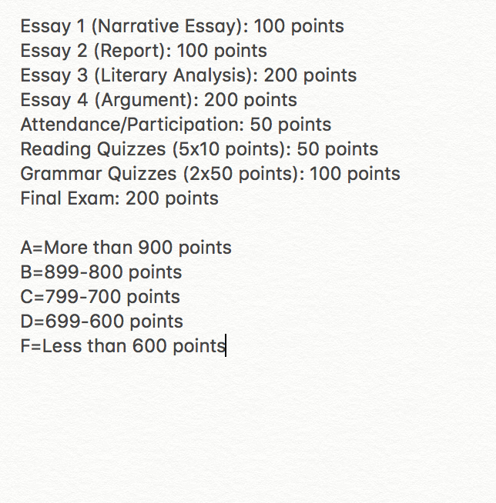
Sample Point-Based Grading Policy
The example grading policy reflected in Canvas

Slide 3
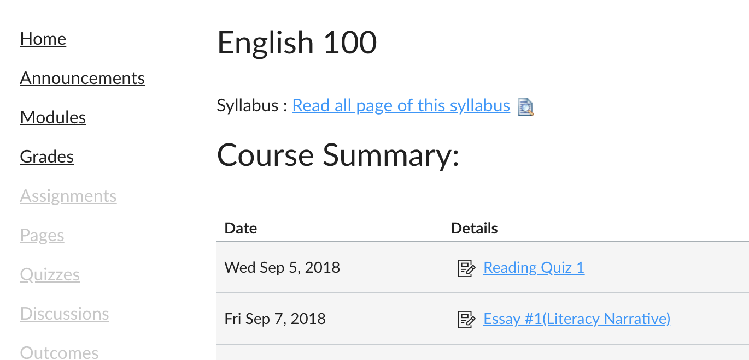
To Set Up Grades, click on “Assignments”
NOTE: “Assignments” may be greyed out; this means your students do not have access, but you can access it as an instructor. “Assignments” is the back-end of your gradebook.

Slide 4
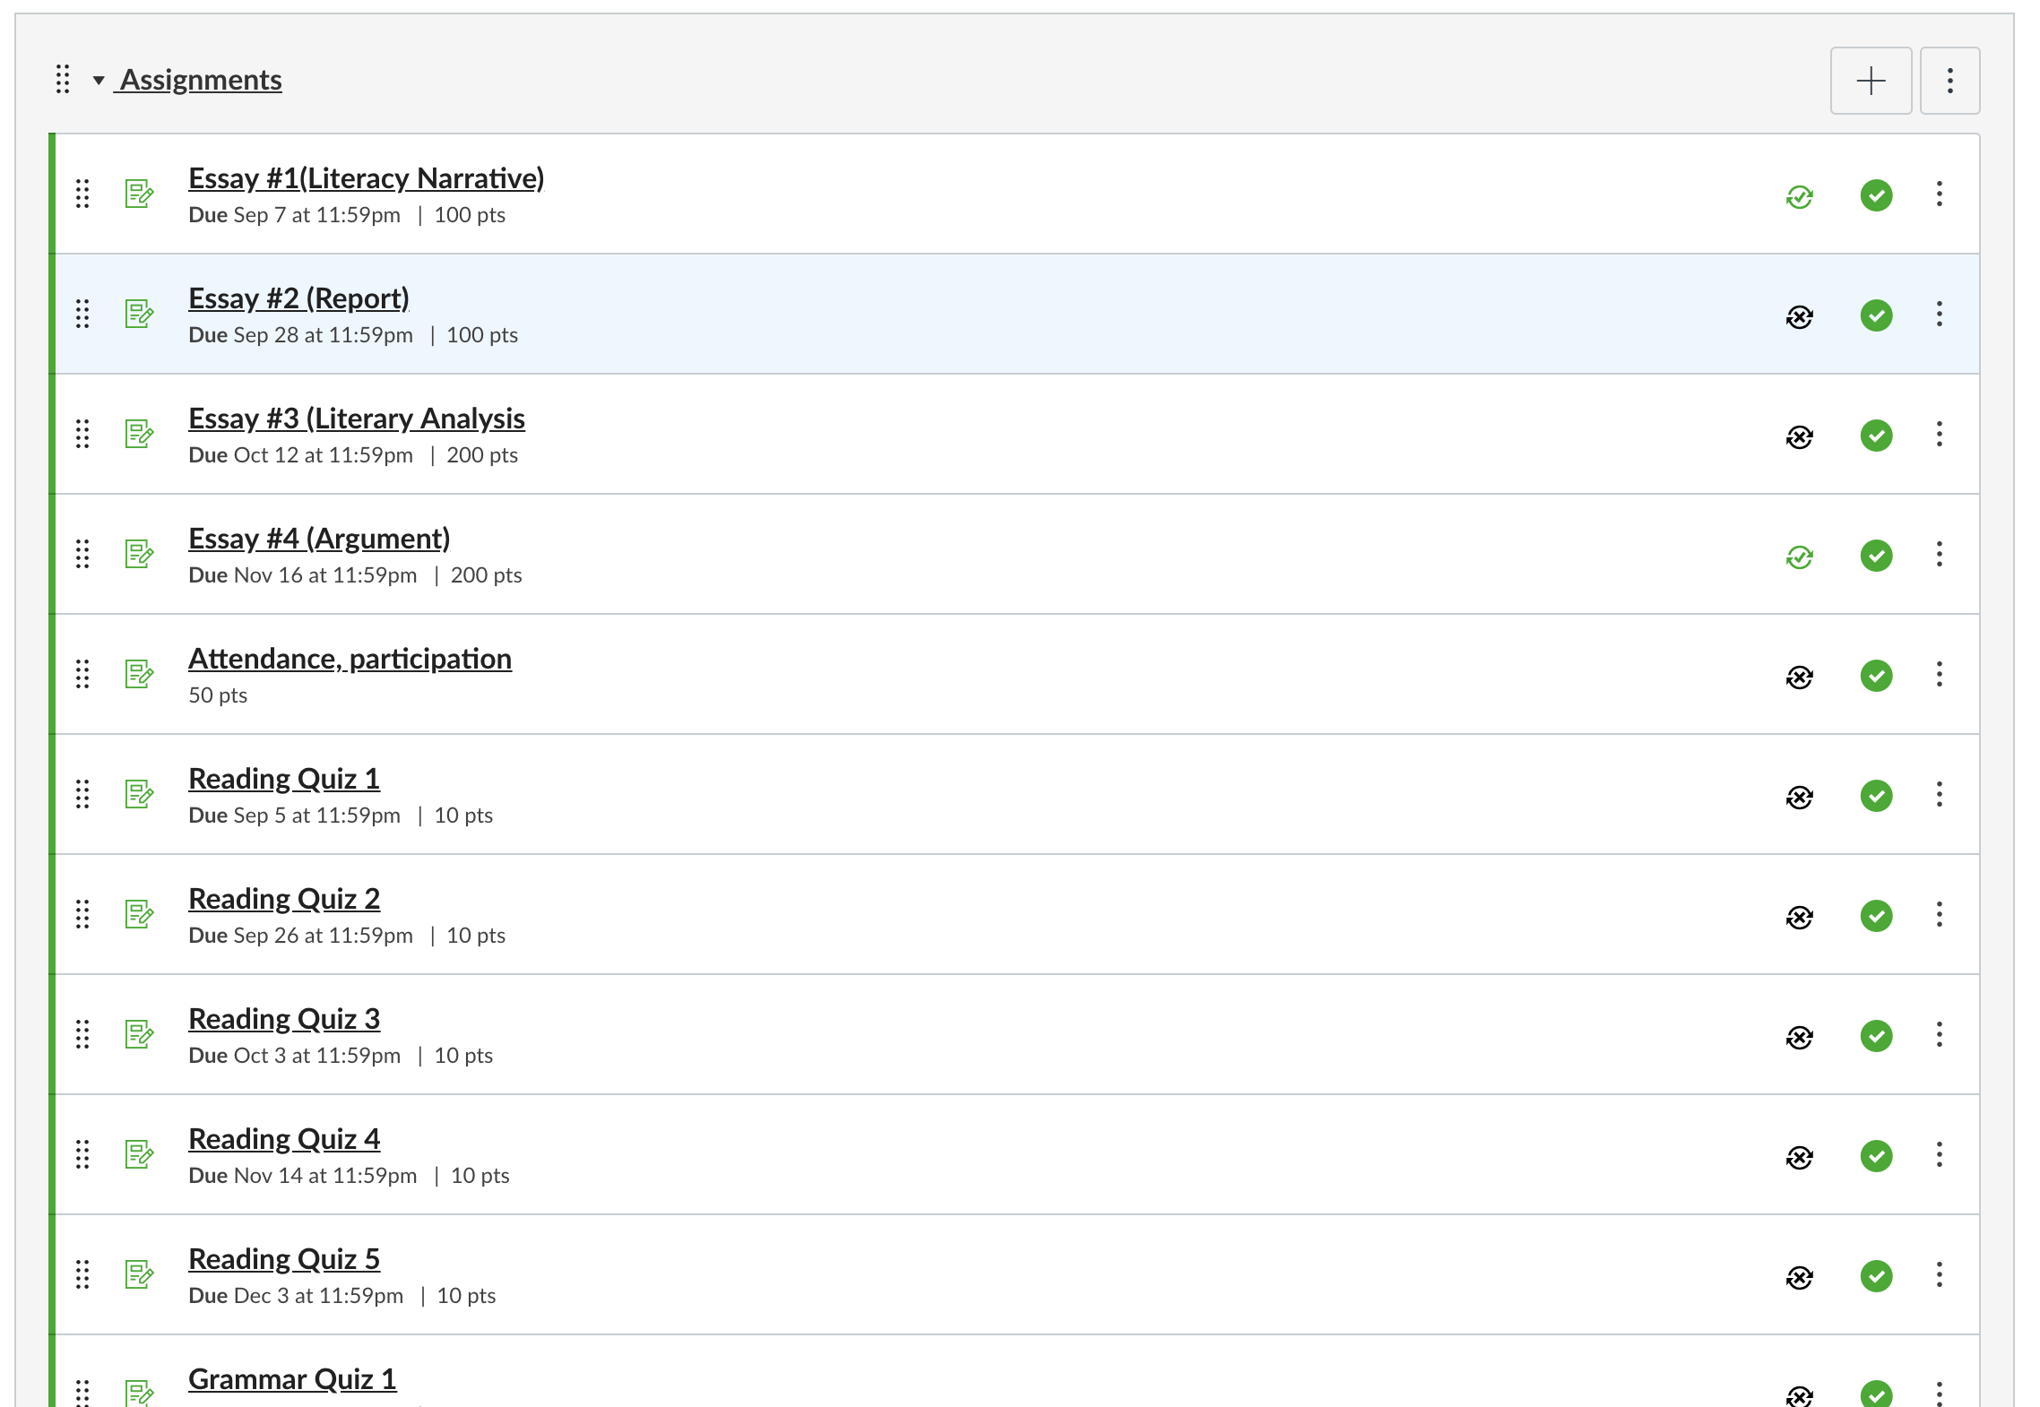
You will have a default assignment group called “Assignment”. This cannot be deleted. It is the percentage of grades entered all weighted equally. You may choose to rename it “Current Earned Grades”.
Note: If you only have 1 assignment group called “Assignments” and have all the columns needed under it, you have completed the point-based grade set up.
Be sure to review the “Tips and Tricks” on the last slide.

Slide 5
OPTIONAL: Deleting Unwanted Groups

Slide 6
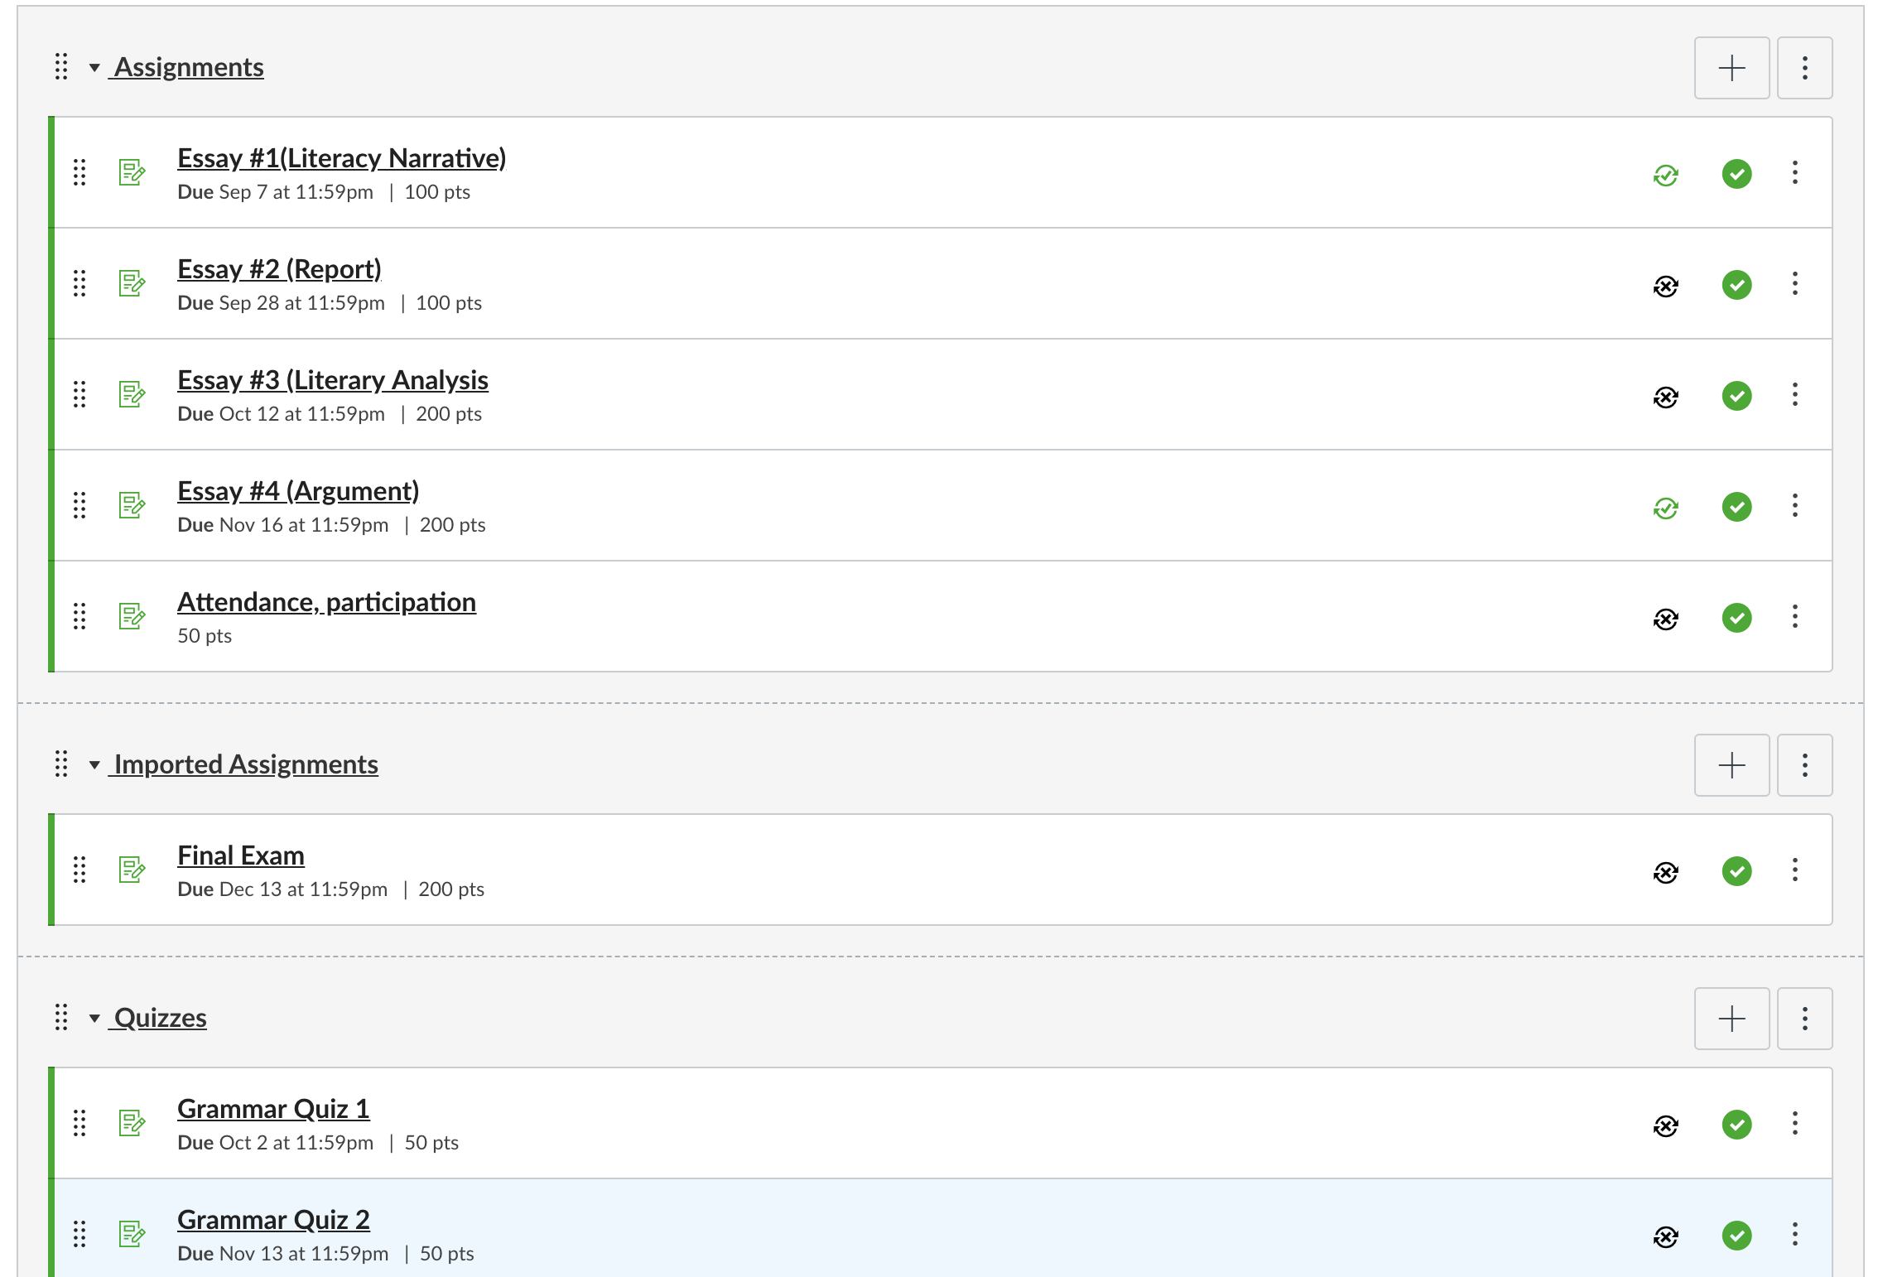
If you have imported content from other sources (example, another LMS like Blackboard or from a QTI file), you may have some unwanted assignment groups. In this example, there are 2 unwanted assignment groups.
There are unwanted assignment groups

Slide 7
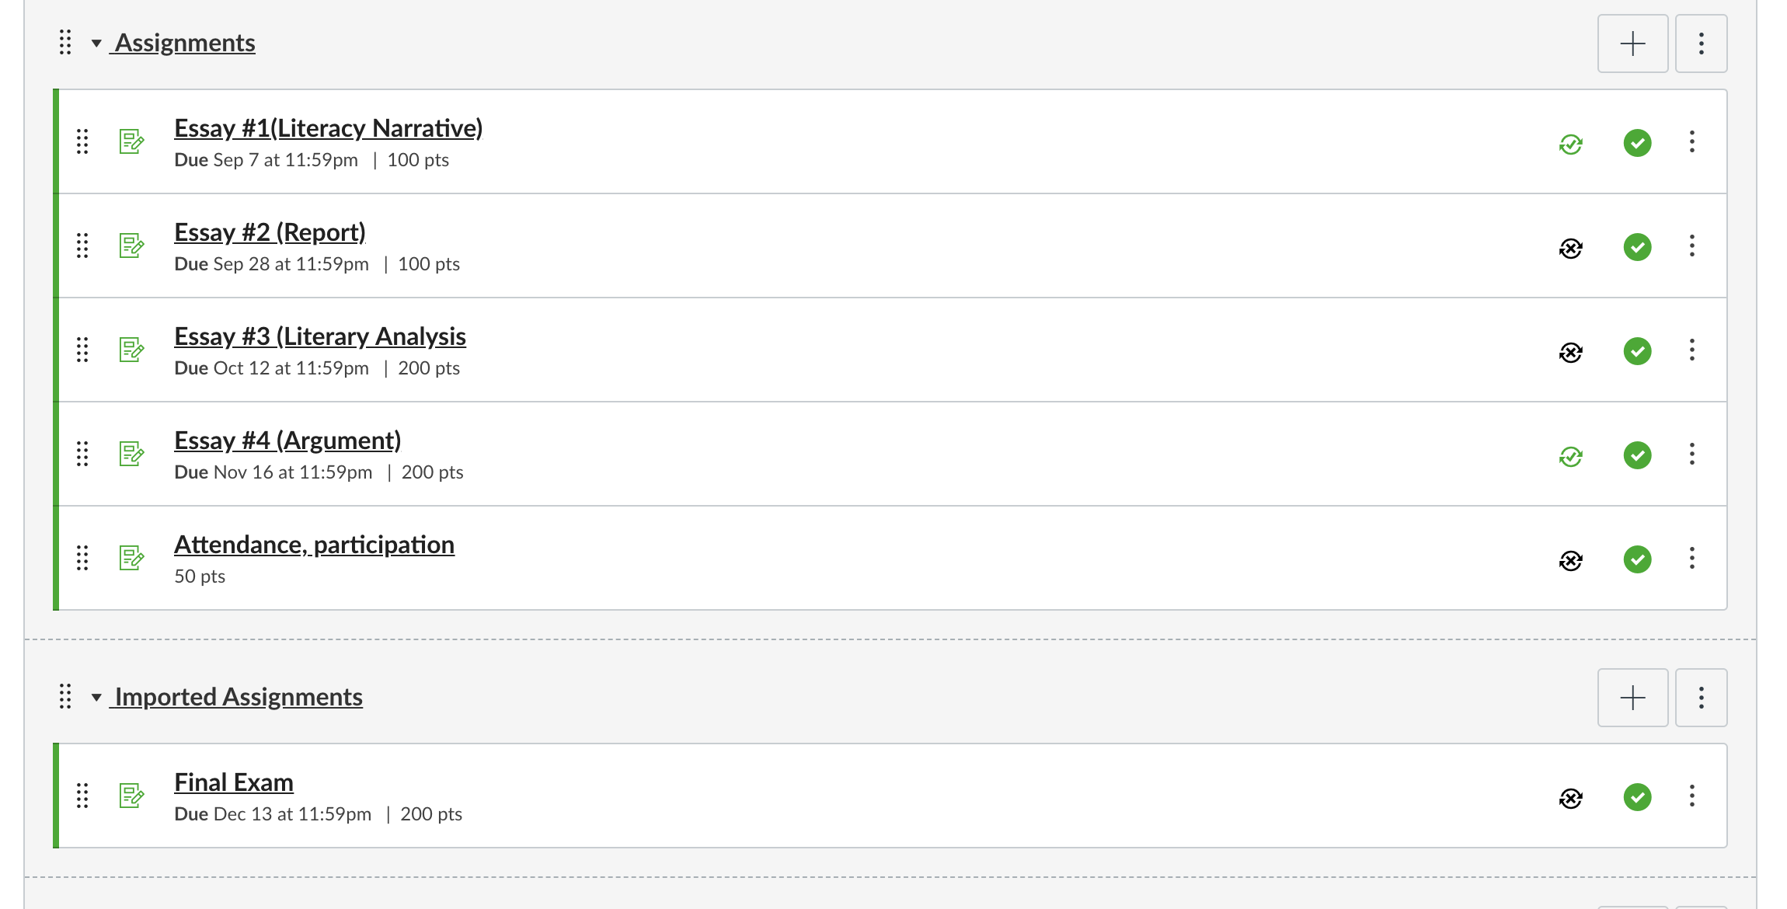
Before Clean Up
When you place your mouse over the left of the column, you can drag the column above, to be under the “Assignments” group
After Clean Up

Slide 8
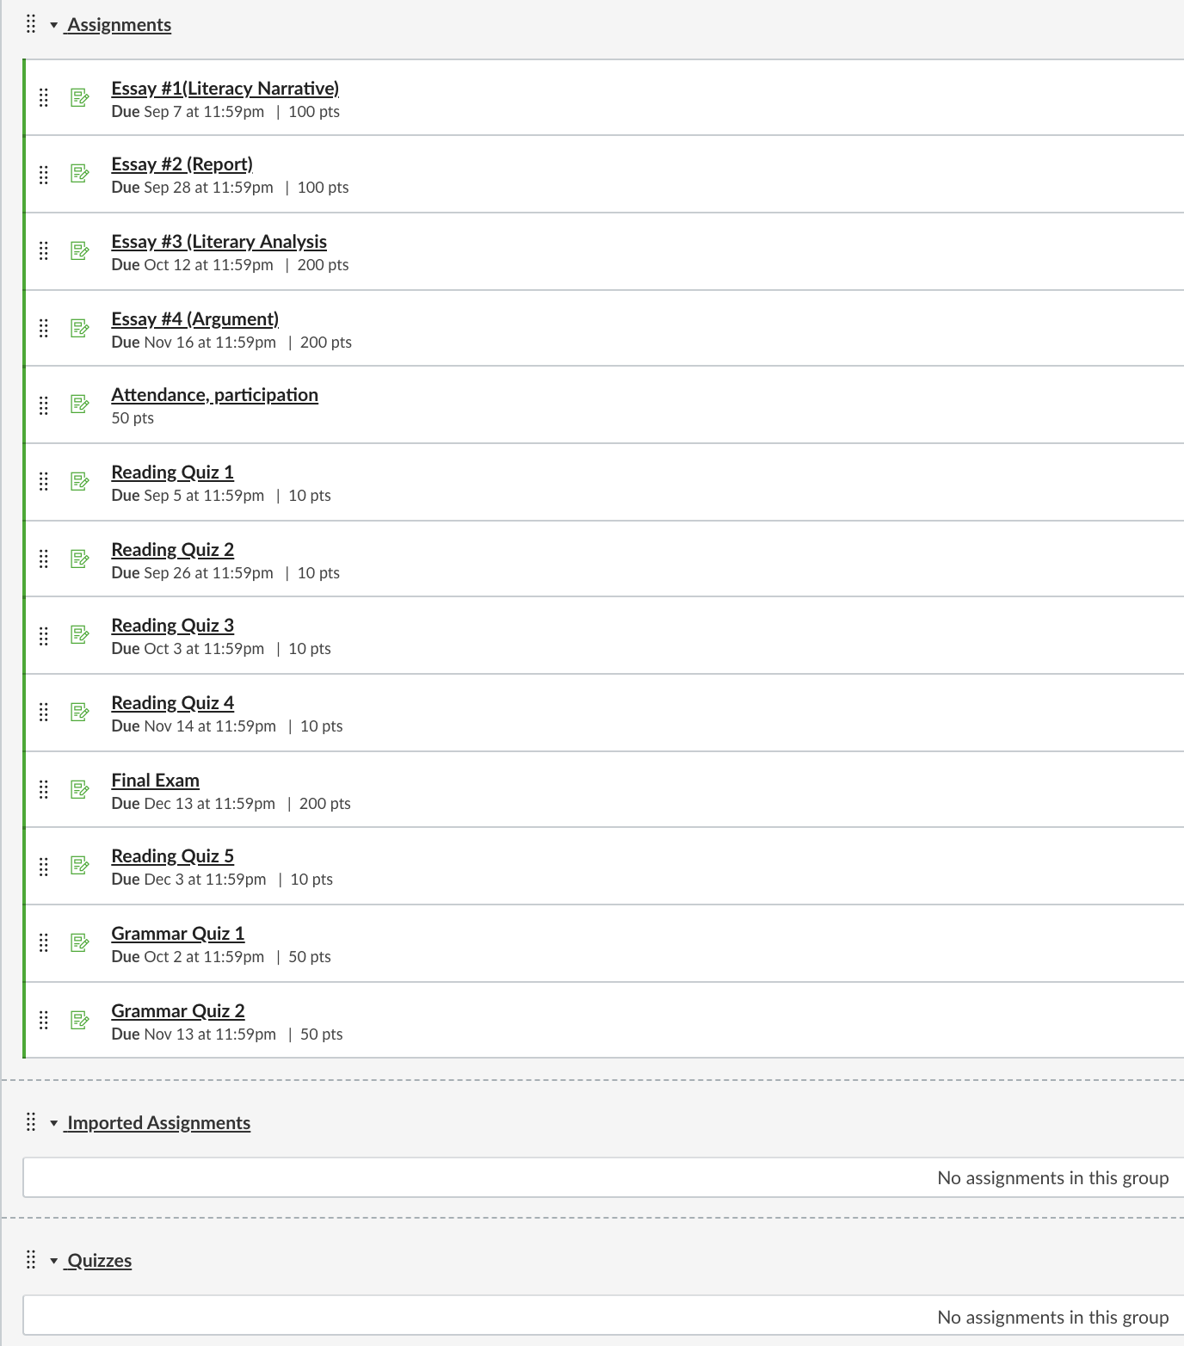
Move all the assignments to be under the one titled “Assignments”. Also rearrange the order of the assignments as desired.
Mouse over the 3 dots on the right of the unwanted assignment groups and delete.

Slide 9
Your gradebook is now set-up
The example grading policy reflected in Canvas

Slide 10
Tips and Tricks

Slide 11
Tips and Tricks
Under “Grades”, mouse over the “Total” column. Click the arrow and “Switch to Points”.
To verify gradebook accuracy:
Go to “Home” and “Student View”. This adds a Test Student to your course and under “Grades”
“Leave Student View”
Under the teacher view, go to “Grades” and for the Test Student, add the maximum points possible for every assignment.
Under the “Total” column, student should have the maximum points possible
If a student misses an assignment, you need to enter a 0 for the column.

