Slide 1
Using data to reflect on and transform practice – A model based on Love’s Data Literacy approach
Dr. Allen Guidry – HIED
East Carolina University

Slide 2
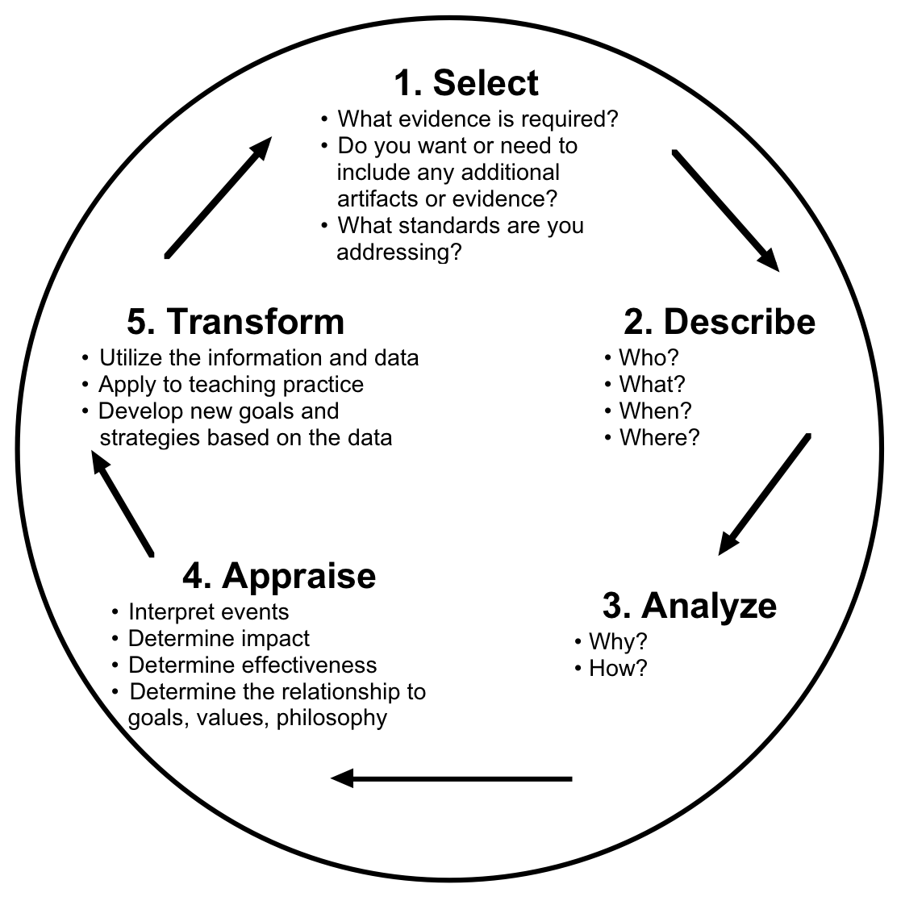
Reflective Teaching Cycle

Slide 3
Root of all reflection
Your reflection, whether self reflection or reflecting with peer(s) should be rooted in observable, demonstrable, or measurable (ODM) evidence of student learning around the chosen objectives of the lesson

Slide 4
Reflecting on content
Did I teach content in enough depth?
Was my content presented in the right sequence?
Did I reiterate major content points?
What would I do differently in the next lesson or what would I do differently the next time I taught this based on the evidence I’ve examined?

Slide 5
Reflecting on instruction
Did I use the best method for the content?
What was successful about my instructional approach and what was the ODM evidence that it was successful?
What positive will I take from this lesson?
What was not as successful about my instructional approach and what was the ODM evidence that is was not successful?
What lesson have I learned about teaching in this learning segment?

Slide 6
Reflecting on assessment
Did I use ongoing formative assessment in teaching this lesson?
Did I collect ODM evidence that students understood the content, concepts, skills, and ideas I was trying to teach related to the learning objectives in this lesson?
Did I provide feedback to students (either positive or areas for growth) based on the ODM evidence I collected?
Did I help students see how they could improve through my feedback?
Did I give students an opportunity to self-assess?
What would I do differently in the next lesson or what would I do differently the next time I taught this based on the assessment data? What might I need to re-teach?

Slide 7
Reflecting on support to students
Did I identify students who needed additional help through my instructional and assessment approach?
In what ways did I provide assistance to those students?
What were my missed opportunities relative to student support and how will I assure that those opportunities aren’t missed in the future?

Slide 8
Taking action – changes and next steps
Overall, what changes would I make to address individual and collective learning needs related to the central focus of this lesson? How can I use research and/or theory to guide my instructional or assessment changes?
Based on the ODM evidence I’ve collected in this lesson, what next steps will I need to take to provide targeted support to individuals AND groups to improve their learning relative to:
Facts, concepts, and ideas in the lesson
inquiry, interpretation, or analysis of sources in the lesson
Skills sets (e.g. building and supporting arguments or conclusions)
What research, theories, or best practices help me justify these next steps?

