Slide 1
WF Faculty Seminar
Fall 2014 | Last Day Reflection

Slide 2
What?
What happened this semester?
What did you do?
What did you expect and what was different?
What did you learn?

Slide 3
So what?
Why does what you’ve done matter. . .
to students?
to you?
to the department?
How is the work you’ve done informed by a larger conversation. . .
what you’ve read?
what you’ve discussed?

Slide 4
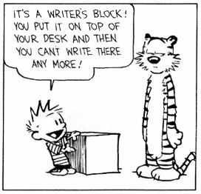
Now what?
How can you apply what you’ve learned?
What would you like to learn more about?
What work do we need to do to address challenges or difficulties?
What do you want us to do more of/less of next semester?
What else is needed for you to be prepared to teach 2201?

Slide 5
For Spring 2015
Visits from Writing Liaisons/Librarians
List of questions prior to visit (work on early in semester)
Planning Material for Focused Sections
Citation conventions
More types of assignments
Review assignments
Present assignments
Reviewing Texts—articles, multimedia, etc.
Class Activities
Allow time to plan out course/daily schedule
themes
Beyond College Discourse Communities
Career Services/Alumni
Designate small group days
Pilot section share
Observe 2201 pilots

Slide 6
See you in January
We are in RAWL 102 | 3:30-4:45pm

